Slide 1
Soil classification & crop suggestion using machine learning

Slide 2
INTRODUCTION
There are so many soil series available in India.
Every soil series have different features and every soil is suitable for different crop.
The main purpose of the proposed work is to create a suitable model for classifying various kinds of soil series data along with suitable crops suggestion.
Series are recognized by machine learning methods using various chemical features and possible crops for that soil series are suggested using geographical attributes.

Slide 3
Project introduction
There are so many soil series available in India. Every soil series have different features and every soil is suitable for different crop. Sometimes or we can say every time it happens that farmer soil is best for some specific crop but as he don’t know. The main purpose of the proposed work is to create a suitable model for classifying various kinds of soil series data along with suitable crops suggestion.
Series are recognized by machine learning methods using various chemical features and possible crops for that soil series are suggested using geographical attributes. Soil is one of the key components in agricultural field for yielding crops. Soil classification philosophies follow the existence knowledge and practical circumstances. On the land surfaces of earth, classification of soil creates a link between soil samples and various kinds of natural entity.

Slide 4
Motivation
key motivation for developing this project is as we say every part of world is developing but we can see that there is no such big achievement or development in soil or crop related issues. So we can give preference to this soil field and if we suggest suitable crop to farmers then it is beneficial for them.

Slide 5
Literature survey
Sr.No | Author Name | IEEE Paper Name | Description
1. | Prof. A. V. Deorankar. Ashwini A. Rohankar. | An Analytical Approach for Soil and Land Classification System using Image Processing (2020) | The emphasis is focused on the analytical study of various advanced and efficient classification mechanisms and techniques.
2. | Dr. Y. Jeevan Nagendra Kumar, V. Spandana, V.S. Vaishnavi, K. Neha | Supervised Machine learning Approach for Crop Yield Prediction in Agriculture Sector (2020) | Crop yield prediction incorporates forecasting the yield of the crop from past historical data which includes factors such as temperature, humidity, ph, rainfall, crop name.
3. | Supriya S. Shinde, Mayura Kulkarni | Review Paper on Prediction of Crop Disease Using IoT and Machine Learning (2017) | The proposed system gives more emphasis to predict diseases of the crop with the use of the Internet of Things and machine learning algorithms. Different sensors collect the real-time data of environmental parameters like temperature, humidity, rainfall, light intensity.

Slide 6
Literature survey
Sr.No | Author Name | IEEE Paper Name | Description
4. | Rakesh Kumar , M.P. Singh , Prabhat Kumar and J.P. Singh | Crop Selection Method to Maximize Crop Yield Rate using Machine Learning Technique (2015) | This paper proposed a method named Crop Selection Method (CSM) to solve crop selection problem, and maximize net yield rate of crop over season and subsequently achieves maximum economic growth of the country. The proposed method may improve net yield rate of crops.
5. | M. Kalimuthu, P. Vaishnavi, M. Kishore | Crop Prediction using Machine Learning (2020) | The seed data of the crops are collected here, with the appropriate parameters like temperature, humidity and moisture content, which helps the crops to achieve a successful growth.

Slide 7
Problem definition/project title
Crop Predication using machine learning.
Problem Definition : Crop Yield Prediction involves predicting yield of the crop from available historical available data like weather parameter, soil parameter and historic crop yield.

Slide 8
objectives
The main goal of this project is to classify soil series.
As well as to predict suitable crop. And detect the Soil Type.

Slide 9
Existing System
In existing system, traditionally without knowing the type of soil, without knowing suitable crop.
Farmer plants his farm and it many times gives him loss. Farmer don’t have the knowledge of crop and soil also.
Crop yield prediction incorporates forecasting the yield of the crop from past historical data.

Slide 10
Proposed System
We need to know the features and characteristics of various soil types to understand which crops grow better in certain soil types.
Machine learning techniques can be helpful in this case.
Then apply apriority Mining process to generate an association rule for finding suitable crops for the specific soil.
Soil series and land type combine represents the soil class in the database.
The machine learning methods are used to find the soil class (i.e. soil series and land type). Algorithm are used: CNN.

Slide 11
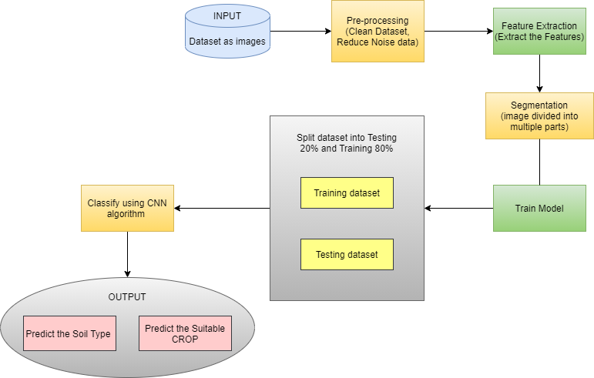
Architecture diagram

Slide 12
SOFTWARE REQUIREMENT
Operating system : 64 bit Windows 10.
Coding Language : Python(TKinter)
IDE : Spyder.
Python Library : Tensorflow, Keras, Opencv, Matplotlib
Database : DBSqlite3

Slide 13
HARDWARE REQUIREMENT
System Processors : Core2Duo
Speed : 2.4 GHz
Hard Disk : 150 GB
RAM : 8 GB

Slide 14
Project modules
Image Selection
Pre-processing
Feature Extraction
Segmentation
Classification

Slide 15
Algorithm required
Convolutional Neural Networks specialized for applications in image & video recognition. CNN is mainly used in image analysis tasks like Image recognition, Object detection & Segmentation.
There are Four types of layers in Convolutional Neural Networks:
1) Convolutional Layer: In a typical neural network each input neuron is connected to the next hidden layer. In CNN, only a small region of the input layer neurons connect to the neuron hidden layer.
2) Pooling Layer: The pooling layer is used to reduce the dimensionality of the feature map. There will be multiple activation & pooling layers inside the hidden layer of the CNN.
3) Flatten: Flattening is converting the data into a 1-dimensional array for inputting it to the next layer. We flatten the output of the convolutional layers to create a single long feature vector.
4) Fully-Connected layer: Fully Connected Layers form the last few layers in the network. The input to the fully connected layer is the output from the final Pooling or Convolutional Layer, which is flattened and then fed into the fully connected layer.

Slide 16
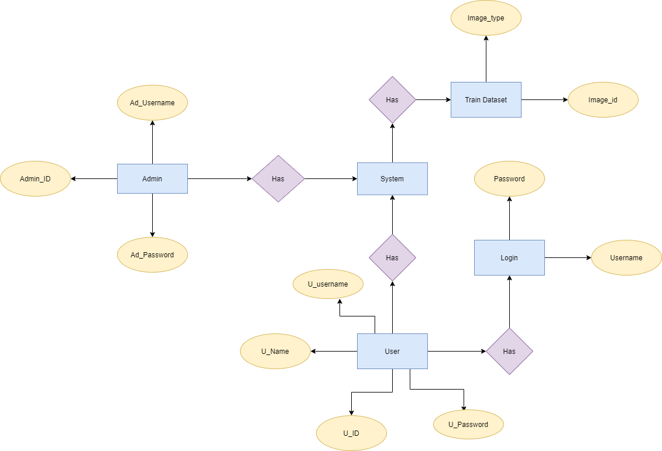
Project E-R diagram

Slide 17

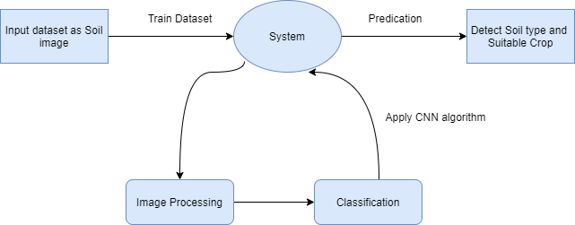
Project data flow diagram
DFD 0 Level Diagram
DFD 1 Level Diagram

Slide 18
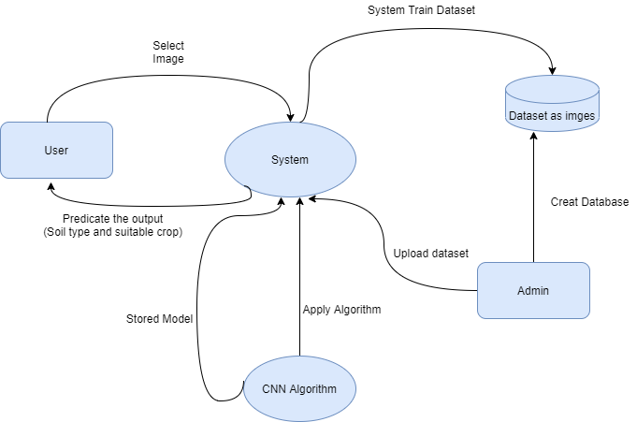
Project data flow diagram
DFD 2 Level Diagram

Slide 19
Functional & Non-Functional Requirements
Performance Requirement-
The performance of the functions and every module must be well. The overall performance of the software will enable the users to work efficiently. Performance of encryption of data should be fast. Performance of the providing virtual environment should be fast.
Safety Requirement-
The application is designed in modules where errors can be detected and fixed easily. This makes it easier to install and update new functionality if required.
Security Requirement-
All data will be encrypted using strong encryption algorithm and according to location encryption is done.

Slide 20
Functional & Non-Functional Requirements
Software Quality Attributes-
Our software has many quality attribute that are given below:-
• Adaptability: This software is adaptable by all users.
• Availability: This software is freely available to all users. The availability of the software is easy for everyone.
• Maintainability: After the deployment of the project if any error occurs then it can be
easily maintained by the software developer.
• Reliability: The performance of the software is better which will increase the reliability
of the Software.
• User Friendliness: Since, the software is a GUI application; the output generated is much user friendly in its behavior.
• Integrity: Integrity refers to the extent to which access to software or data by unauthorized persons can be controlled.
• Security: Users are authenticated using many security phases so reliable security is provided.
• Testability: The software will be tested considering all the aspects.

Slide 21
Project risk & Risk prioritization
If the Training is incomplete or training accuracy goes down then
system can not predict accurate poses or accurate pose points.
Our Project first risk is dataset as a input.

Slide 22
Mathematical Model
Let S be the Whole system S= {I, P,O}
I - input
P - procedure
O - output
Input( I)
I={ Input as soil image Dataset }
Where,
1. Dataset contain Soil images dataset.
Procedure (P),
P= 1. Train the dataset (Soil image dataset)
2. Pre-processing
3. Feature Extraction
4. Segmentation
4. Classification (used CNN algorithm)
5. Create Model.
Output (O)-
O= 1. System detect Soil type.
2.Predict the suitable Crop.

Slide 23
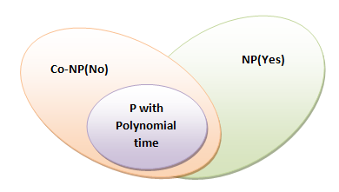
NP Theory
What is P?
P is set of all decision problems which can be solved in polynomial time by a deterministic.
Since it can be solved in polynomial time, it can be verified in polynomial time. Therefore P is a subset of NP.
P:
A novel abstractive multi-document summarization system based on chunk-graph (CG) and recurrent neural network language model (RNNLM).
A CG which is based on word-graph is constructed to organize all information in a sentence cluster, CG can reduce the size of graph and keep more semantic information than word-graph.
System outperforms all baseline systems and reach the state-of-art systems, and the system with CG can generate betters ummaries than that with ordinary word-graph.

Slide 24
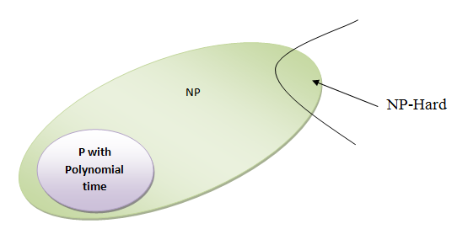
NP Theory
What is NP?
"NP" means "we can solve it in polynomial time if we can break the normal rules of step-by-step computing".
What is NP Hard?
A problem is NP-hard if an algorithm for solving it can be translated into one for solving any NP-problem (nondeterministic polynomial time) problem. NP-hard therefore means "at least as hard as any NP-problem," although it might, in fact, be harder.
Np-Hard:
A CG which is based on word-graph is constructed to organize all information in a sentence cluster, CG can reduce the size of graph and keep more semantic information than word-graph. We use beam search and character-level RNNLM to generate readable and informative summaries from the CG for each sentence cluster, RNNLM is a better model to evaluate sentence linguistic quality than n-gram language model. the system with CG can generate better summaries than that with ordinary word-graph.

Slide 25
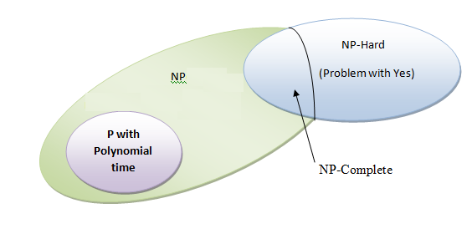
NP Theory
What is NP-Complete?
Since this amazing "N" computer can also do anything a normal computer can, we know that "P" problems are also in "NP". So, the easy problems are in "P" (and "NP"), but the really hard ones are *only* in "NP", and they are called "NP-complete". It is like saying there are things that People can do ("P"), there are things that Super People can do ("SP"), and there are things *only* Super People can do ("SP-complete").
NP-Complete:
As our system is in developing state so we can’t say that our system is currently in NP complete state
Ideas of pattern-growth in uncertain environment:
The ideas of pattern-growth in uncertain environment,
two alternative algorithms are designed to discover
all the STP candidates with support values for each user.
That provides a trade-off between accuracy and efficiency.
The user-aware rare pattern concerned here is a new
concept and a formal criterion must be well defined,
so that it can effectively characterize most of personalized
and abnormal behaviors of Internet users.

Slide 26
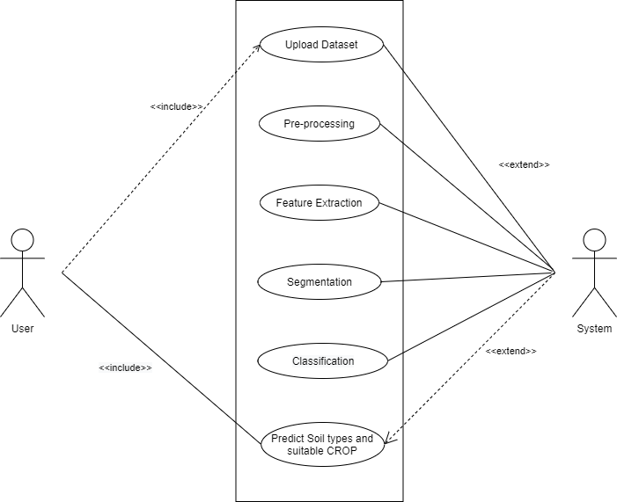
Use-case diagram

Slide 27
Future scope
In reference to rainfall can depict whether extra water availability is needed or not. This research work can be enhanced to higher level by availing it to whole India.
Crop diseases detection using Image Processing where users can upload picture of diseased crop and get pesticides recommendations.
Implementation of Smart Irrigation System to monitor weather and soil conditions, plant water usage etc. to automatically alter watering schedule.

Slide 28
Conclusion
A model is proposed for predicting soil series and providing suitable crop yield suggestion for that specific soil.
The model has been tested by applying different kinds of machine learning algorithm.
CNN shows highest accuracy in soil classification and suggests crops with less time. It gives us more accuracy as compared to existing system and gives more benefit to farmers.

Slide 29
REFERENCES
[1]Y Jeevan Nagendra Kumar; V. Spandana; V.S. Vaishnavi; K. Neha;V.G.R.R Devi., 2020. Supervised Machine learning Approach for Crop Yield Prediction in Agriculture Sector.
[2]Fatin Farhan Haque; Ahmed Abdelgawd; Venkata Prasanth Yangmbaka; Kumar Yelamarathi.,2020,Crop Yield Analysis Using Machine Learning Algorithms.
[3] R. Nikhil; B.S. Anisha; Ramakanth Kumar P., 2020,Real-Time Monitoring of Agricultural Land with Crop Prediction and Animal Intrusion Prevention using Internet of Things and Machine Learning at Edge.

Slide 30
THANK YOU..
FOR GIVING YOUR VALUABLE TIME…

